Slide 1

Amazon Web Services
workshop
for System Engineer
Using Amazon
Elastic Compute Cloud (EC2)

Slide 2
Topics
Understand of Amazon EC2
EC2 Instance Types
EC2 Lab

Slide 3
Objectives
You will be able to
Describe differences between EC2 types.
Create EC2 instances from AMIs.
Remote and Install software on EC2
Create EC2 snapshot
Create another EC2 instances from your own AMIs.

Slide 4


Introduction to EC2

Slide 5
Amazon Elastic Compute Cloud (EC2)
Amazon Elastic Compute Cloud (Amazon EC2) is a web service that provides resizable compute capacity in the cloud. It is designed to make web-scale cloud computing easier for developers.
Virtual Server in the Cloud that…
Resizable compute capacity.
Complete control of computing resources
Instance can be start, terminated, and monitored as needed using APIs and management tools.
Typically take less that 10 minutes to spin up.
Scale capacity as your computing requirements change.
Pay only for capacity that you actually use.

Slide 6
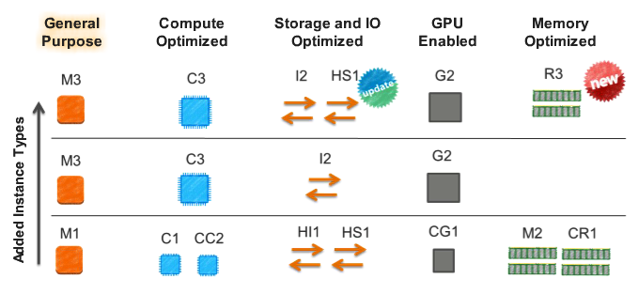
Broad Set of Computer Instance Types

Slide 7
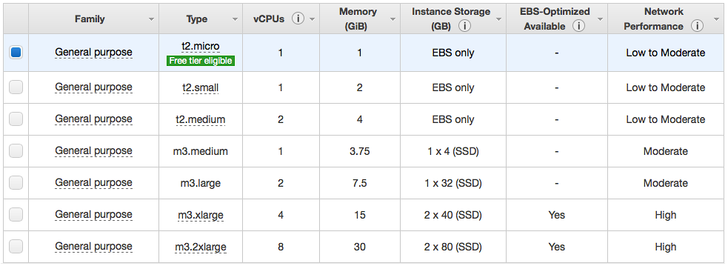
EC2: Instance Types
General Purpose :- Provide customers with a balanced set of resources and a high level of processing performance on a low cost platform.Ideal for application that require balance CPU and memory performance.

Slide 8
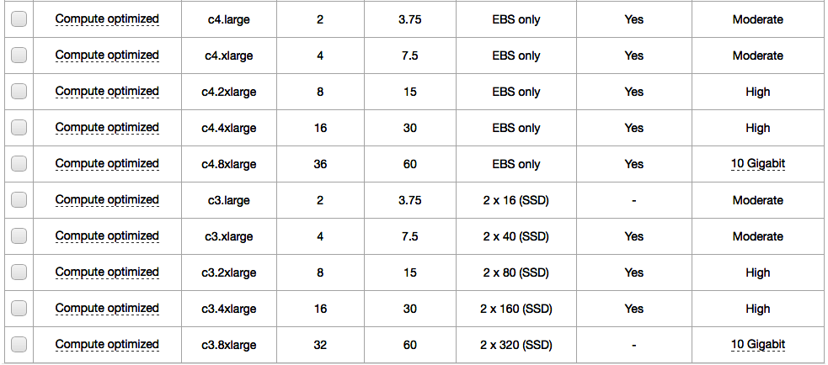
EC2: Instance Types
Compute Optimized :- Compute Optimized instances have proportionally more CPU resources than memory and are well suited for computer-intensive applications

Slide 9
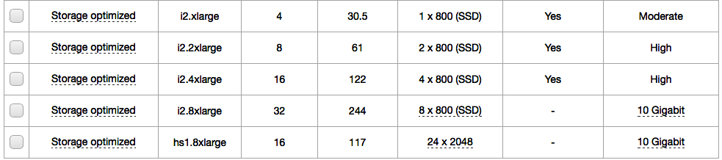
EC2: Instance Types
Storage and IO Optimized :- Provide very high disk IO performance or proportionally higher storage density per instance, and are ideally suited for applications that benefit from high sequential IO performance across very large data sets. Storage-optimized instances also provide high levels of CPU, memory and network performance.

Slide 10
EC2: Instance Types
GPU Enabled :- GPU instances provide graphics process units along with high CPU and network performance for applications benefiting from highly parallelized processing, including 3D graphic, HPC, rendering, and media processing applications

Slide 11
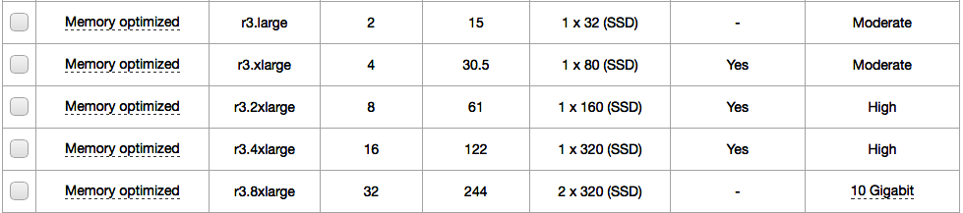
EC2: Instance Types
Memory Oprimized :- Offer large memory sizes for high throughput applications including relational and NoSQL databases, in-memory analytics solutions, scientific computing, and other memory-intensive applications.

Slide 12
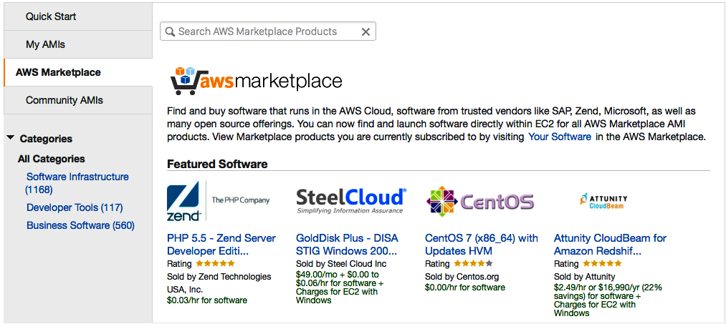
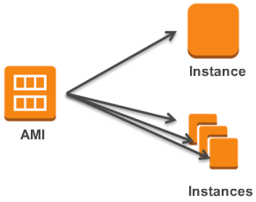
Amazon Machine Image (AMI)
Building blocks of Amazon EC2 Instances
An AMI is an pre-configured template/image of a server, including an Operating System and often additional software which runs on AWS.
Create hardened or gold “images” of your Amazon EC2 infrastructure.
AMIs have various configurations of CPU, memory, storage, and networking capability for your instances.
Hundreds of pre-configured AWS and partner AMIs available on AWS Marketplace.

Slide 13
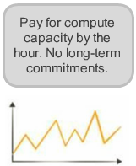
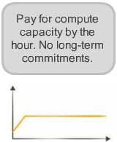
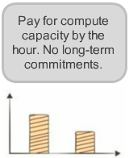
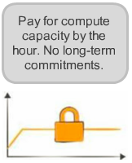
EC2 Cost Model
Customers can combine multiple purchase types to optimised pricing based on current and forecast capacity needs.
On-Demand
Reserved
Spot
Dedicated
Spiky workloads
Committed utilization
Time-Insensitive
workloads
Highly sensitive
workloads

Slide 14
EC2 Cost Model
On-Demand Instances :-
Let you pay for compute capability by the hour with no long-term commitments.
This frees you from the costs and complexities of planning, purchasing, and maintaining hardware and transforms what are commonly large fixed costs into much smaller variable costs.
Reserved Instances :-
Give you the option to make a low, one-time payment for each instance you want to reserve and in turn receive a significant discount on the hourly charge for that instance.
This is good for steady-state workloads who want to pay upfront in exchange for hourly prices that are 50-75% lower than what you get for on-demand instances.
Spiky workloads
Committed utilization

Slide 15
EC2 Cost Models
Spot Instance :-
Enable you to vid for unused Amazon EC2 capacity. Instances are charged the Spot Price, which is set by Amazon EC2 and fluctuates periodically depending on the supply of and demand for Spot Instance capacity.
This is good for customers who have opportunistic workloads that can afford to be interrupted and want the lower possible price.
Reserved Instances :-
Ensure your EC2 instance will be isolated at the hardware level to maximize customers run reserved instances for their steady-state workload and maximized their saving on a per-hour basis.
EC2 instances lunched within your VPC that run hardware dedicated to single customer.
Time-Insensitive
workloads
Highly sensitive
workloads

Slide 16
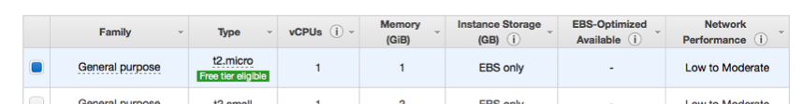
EC2 Free Tier
Amazon provided free tier for S3 within certain usage limits.
750 hours per month of Linux, RHEL, or SLES t2.micro instance usage.
750 hours per month of Windows t2.micro instance usage.
Run one instance at a time or multiple instances simultaneously.
750 hours of Elastic Load Balancing plus 15 GB data processing.
30 GB of Amazon Elastic Block Storage in any combination of General Purpose (SSD) or Magnetic, plus 2 million I/Os (with Magnetic) and 1 GB of snapshot storage.
15 GB of bandwidth out aggregated across all AWS services.
1 GB of Regional Data Transfer.
For full EC2 pricing details. See http://aws.amazon.com/ec2/pricing/

Slide 17


Case Study:

Slide 18
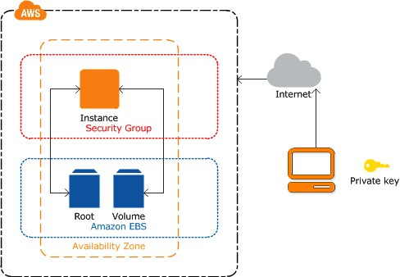
EC2 Instance Architecture
The instance is an Amazon EBS-backed instance (meaning that the root volume is an Amazon EBS volume, also an additional attach Amazon EBS volume).
You can either specify the Availability Zone in which to launch your instance, or let us select an Availability Zone for you.
When you launch your instance, you secure it by specifying a key pair and security group.
When you connect to your instance, you must specify the private key of the key pair that you specified when launching your instance.

Slide 19
Lab: Introduction to Amazon EC2
Overview
This guide introduces you to Amazon Elastic Compute Cloud (EC2) using the AWS Management Console. You will be able to create Amazon EC2 instance and install software on it at the end of this lab.
2 labs.
Topic Covered
Create Linux Ubuntu 14.04 LTS Server on EC2
Defines AWS Security Group
Create Public/Private Certificate key
Remote to EC2 instance with SSH from Windows or Linux/OS X
Note:
Do not delete ECS instance after complete this lab. It will be used in the next chapter.

Slide 20
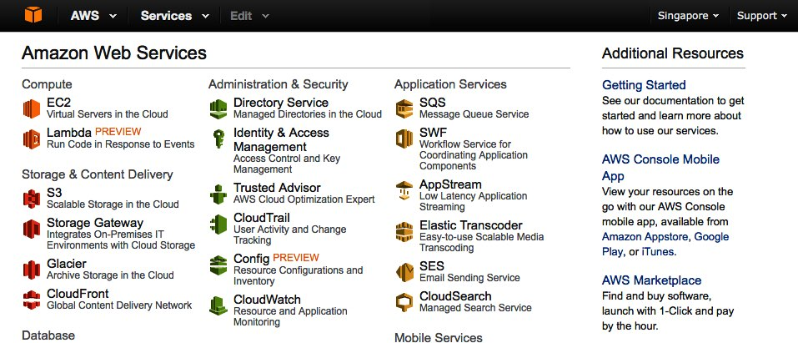
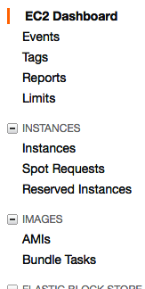
Lab 1-2: Login to AWS Console
Goto https://console.aws.amazon.com, enter AWS username and password and then click Login button.
In AWS Console, change Region to Singapore.
Click EC2 link under “Compute” group to open EC2 service console.
Note:
In EC2 console. You can see links on the left hand side grouped by services, such as Instances, Images, etc. These links are frequently used when you works with EC2.
While you are creating instance, you can leave most of the options as default and change it later, accept Storage and Instance Type.

Slide 21
Lab 1-2: Create EC2 Instance
In EC2 Management page, click Launch Instance button. Note: This will open EC2 “Launch Instance Wizard”. The top of wizard page will display steps to create instances, from “1. Choose AMI” to “7. Review”. You can jump back to previous step after you passthrough its, or you can change every configuration again in before launch instances the the Review step.
Step 1. click Select button for Ubuntu Server 14.04 LTS (HVM), SSD Volume Type - ami-d6e7c084 (64 bit)
Step 2. Leave the instance type set to default, which is t2.micro. Click Next: Configure Instance Details Button. Note: t2.micro is free tier instance that free 750Hrs/month.
Step 3. Leave the default options and click Next: Add Storage.
You can create multiple of instances in each time by defines Number of instances.
You can choose Virtual Private Cloud (VPC) for instances in Network drop down list. AWS provided default VPC for you, so you can leave it this time.
Subnet is created at the same time while you create VPC. Its also define Availability Zone for your EC2 instances.
Leave Auto-assign Public IP as default value. You may disable public IP if you decides to run EC2 instances in private network within VPC.
Shutdown behaviour tell AWS what to de when you stop the EC2 instance. The “Terminate” means delete this instance on shutdown. This is very useful if this instance used in Auto Scaling scenario.
Enable termination protection helpful when you have many administrators and you don’t want anyone to stop this instance accidentally.
Enable CloudWatch detailed monitoring in Monitor section to see more deep in details about your EC2 instance. Additional charges will apply.

Slide 22
Lab 1-2: Create EC2 Instance
Step 4: Add Storage. Leave the default options and click Next: Tag Instance button.
Note: You don’t need to allocate much storage for the instance, because space is used for OS, software binary, configurations, and OS patch. Data that generated should store in separated volume in EBS or S3.
You can choose the type of volume, SSD is recommended.
IOPS stand for Input-output Operation Per Second. More space increase IOPS rate. For example :- if you needs 30 baseline IOPS, you have to allocates at lease 10GB for storage. More storage means more additional charge.
Storage will be created as volume in EBS.
You can create more volume by click Add New Volume button. Leave it default this time.
Delete on Termination option tells AWS to delete this volume when you terminates this instance. Uncheck it if you want to keep the volume to retrieve anything in the volume later.
Step 5: Tag Instance.
Provide a name for your instance in the Value field of the Name attribute. Uses <your_name>_1 as instance name.
Click Create Tag button. Enter “Group” in the new Key field, and provide <your_name>_group for Value field. Tags are very useful when you have many EC2 instances, it help you to groups and filters instances and other services in AWS.
Click Next: Configure Security Group button.

Slide 23
Lab 1-2: Create EC2 Instance
Step 6: Security Group. Note: Security Group is a set of firewall rules to control the traffic for your instance, you can add rules to allow specific traffic to reach your instance.
Choose Create a new security group for Assign a security group. AWS will create SSH rule for you.
Enter <your_name>_nodered_sg for Security Group Name and leave Description as default.
Click Add Rule button, the new rule type should be Custom TCP Rule, enter Port Range to 1880, change Source to Anywhere.
Click Add Rule button again. Change type to HTTP and leave default for the rest.
Click Review and Launch button.
Step 7: Click Launch button. A Key Pair Dialog appears.
Note: AWS EC2 uses public/private key to login over SSH for Unix and also use it ti generate Administrator’s password for Windows. After certificate is created, public key will be kept under /home/ubuntu/.ssh/ folder and let you download the private key when you click Download Key Pair button. Notice that this is the ONLY chance to keep private key, don’t loss it.
You can use the a key pair for multiple EC2 instances.
Choose Create a new key pair in the first drop down list and enter Key pair name as you wish.
Click Download Key Pair button. Keep private key securely.
Click Launch Instances button.
Click View Instances to see you EC2 instance.

Slide 24
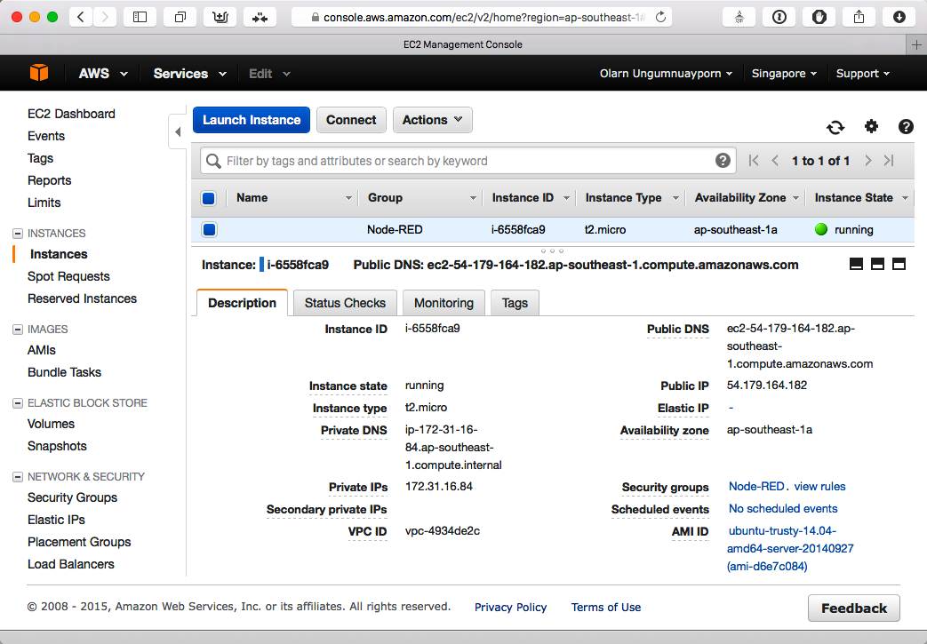
AWS Console: EC2 Instances
how to connect
Choose EC2 Instance and click Connect button to see how to connect to it.
Public IP will be release if you stop instance from Actions menu.
Public DNS also changes because AWS used Public IP as part of DNS name.
Public IP will not change if you Reboot from Actions menu.
To reserves Public IP, you have to allocate Elastic IP and associate it to EC2 instance.
Elastic IP is free if it binding to EC2 instance. Allocate but not associated will be charge.
Additional change for network packages passthrough Elastic IP may apply.
You can have 5 Elastic IPs. But its soft limited. Contact Amazon to describes why you need more.

Slide 25
Lab 2-2: Remote to EC2 Instance (Linux/OS X)
To access your instance from Linux or OS X:
Open Terminal.
Locate your private key file (your private key file should be <your_key_name>.pem.txt, you may optionally change its extension to .pem).
Use this command to change the file permission: sudo chmod 400 <your_key>.pem
Connect to your instance using its Public IP, for example : 10.1.1.111 ssh -i <your_key>.pem ubuntu@10.1.1.111
Please note that in most cases the username above will be correct, however please ensure that you read your AMI usage instructions to ensure that the AMI owner has not changed the default AMI username.

Slide 26
Lab 2-2: Remote to EC2 Instance (Windows)
To access your instance from Windows:
Install PuTTY and PuTTYgen from http://www.chiark.greenend.org.uk/~sgtatham/putty/download.html
Start PuTTYgen. Choose Type of key to generate selected to SSH-2RSA. Click Load button, browse to downloaded private key from step 11. then click Open button. You can see Public Key in text field.
Click Save private key, click Yes on warning dialog then save the file.
Open PuTTY. Enter EC2 IP address or DNS in the Host name field in Session category.
Open Connection > Auth, click Browse button then browse to generated private key in step 2. Click Open button in PuTTY to connect to EC2 instance.
In terminal screen, enter ubuntu for login user.
Type exit to logout from SSH session.
Please note that in most cases the username above will be correct, however please ensure that you read your AMI usage instructions to ensure that the AMI owner has not changed the default AMI username.
https://docs.aws.amazon.com/AWSEC2/latest/UserGuide/putty.html

Slide 27
Conclusion
Elastic Web-Scale Computing
Complete Controlled
Flexible Cloud Hosting Services
Designed to use with other Amazon Web Services
Reliable
Secure
Inexpensive
Easy to Start

Slide 28
References
Amazon EC2 http://aws.amazon.com/ec2/
EC2 Pricing http://aws.amazon.com/ec2/pricing/
EC2 Documentation http://aws.amazon.com/documentation/ec2/

